Slide 1

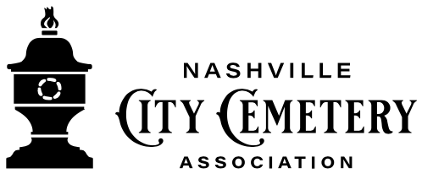
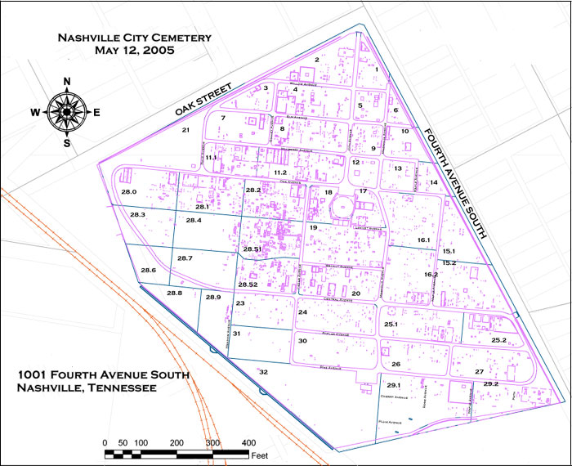

Welcome to Smashville!
While you’re in town, please stop by The Nashville City Cemetery, located at 1001 4th Avenue South, is the oldest continuously operated public cemetery in Nashville. On March 9, 1820, the mayor and aldermen of Nashville purchased four acres of land located “on the plains, south of town, for its burying ground.” The cemetery opened on January 1, 1822.
Since the opening, there have been 20,000 interments in the City Cemetery and several removals.
Did you know the #1 Cause of Death was “Consumption”?
NO, NOT from Alcohol.
AND, another top cause of death was “Flux”. What’s the flux?
Visit NCC to learn more.

